Slide 1
ETSI & 3GPP Collaborative Drafting Platform (New Working Methods Project)
NWM Team
28.08.2020

Slide 2
Why?

Slide 3
Workload and external factors are forcing change
  During 2017:
    Around 16 000 3GPP delegates participated in 139 meetings,
    Over 100 000 T-Docs were uploaded
    Over 9 000 Change Requests handled
    And 2 351 deliverables were published.
  And the trend is upwards
    December 2018 TSGs: 4500 CRs
    June 2020 TSGs: 5000 CRs
  Covid-19 forces online or hybrid meetings, for foreseeable future
    ETSI committees already extensively use online and hybrid meetings
  Many industries are re-evaluating their collaborative drafting processes, methodologies and tools
  Shouldn’t we be doing the same?

Slide 4

Issues we all face…
Struggling
with styles
and layout
Inconsistent
normative
references
Uploading
to the
portal
Preparing
a
Change
Request
Implementing
Change
Requests
Conflicting
Change
Requests
Fixing
Quality
at the end
Finding the
latest version
of a draft
Managing
multiple
local copies
Inconsistent
cover
pages
At a meeting
2000+
documents,
hundreds
of emails
Info spread
over ftp,
email,
portal
No
automated
process
control
Notes:
1) Wrong styles
2) When starting a revision of a document you need to find the right version of the document. Where is it? Has the chair a newer version with comments included etc.
3) Incomplete list of references that you use ; incorrect referencing; no deep links possible
4) When drafting in a team; use email+attachment+append with initials
5) Ask somebody new to upload a document ☺
6) Document contains something else as what the cover page describes
7) Too cumbersome and hence hardly used at ETSI
8) How to keep the oversight? How to compare?
9) Big meeting and lots of documents (redundancy in CRs)
10) Information spread wide. How to keep the oversight?
11) No process control

Slide 5
The motivation to change?
  By taking advantage of modern collaboration and drafting approaches NWM hopes to achieve the following:
    To help ETSI & 3GPP committees to draft and maintain standards as efficiently as possible;
    To ensure the highest editorial and technical quality of our Deliverables;
    To facilitate closer integration with Member working practices;
    To give an added value for end-users;
    To enable increased throughput by the ETSI Secretariat;
    To be attractive to the next generation of standardizers.

Slide 6
Background Concept & Scope

Slide 7

Fundamentals of a generic drafting process
  Drafting = taking a document from content state D1 -> content state D2
  Fundamental drafting process characteristics
    Well-defined roles (responsibilities, permissions etc.)
    Submission of proposed modifications (by some means)
    Review of the proposed modifications (by some means)
    Decisions based on those proposed modifications
    Actions taken as a result of those decisions
    Integration of the (accepted) modifications into the baseline
    Time (sync points , durations, deadlines, overlaps … )
    Quality control (editorial & technical, progress and oversight … )
    Ability to split work off into sub-processes
    Traceability of decisions, actions, modifications etc.
A Variant is a linked modified copy (child) of a base (parent) document
By looking at how we do this ...
… and tweaking these parameters
… we can accommodate various modes of working (= processes)

Slide 8

Can be summarized in this conceptual model
Can be a
Meeting cycle
Document
Variant cycle
Issue cycle
:
COLLECT
SHARE
Roles
Decisions
Actions
Timing
Quality
INTEGRATE
DISCUSS
This is a conceptual model. It is neither a process description nor a state diagram. It is simply an aid to understanding and a hook for a neutral terminology

Slide 9
Various drafting scenarios
Only meeting based
Quality
Start
Approval
Meeting based with significant interim drafting
Quality
NWM concept allows for
  24/7 collaboration – drafting, discussion and consensus building
  Continuous (automated) integration of variants
  Automated Quality
  Full transparency
  Added value
  ……
Start
Approval
Continuous drafting - no meetings except formal approval
Quality
Start
Approval
Continuous drafting with heavy parallelism
Quality
Start
Approval

Slide 10
Scope
  Collaboratively writing, reviewing and approving (standardization) documents
  Easy WYSIWYM semantic authoring
  Browser based web application
  License free
  Disconnected mode
  Extensible (API based)
  Flexible output support
  Configurable workflows and document lifecycle
  Validation of document contents against a set of quality rules

Slide 11
Outline Solution

Slide 12

NWM - in a nutshell
STF Leader
Share
Chair
Delegates
EditHelp
Technical Officers
Rapporteur

Slide 13
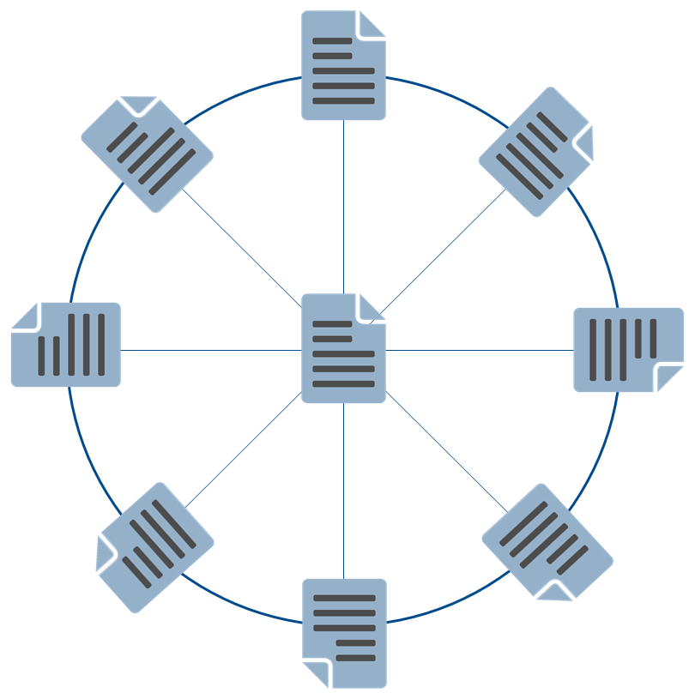
The In-Document User Experience
User Tagging
Identification of Requirements,
Features, Capabilities and more
Personal Annotations
Publishing
Various publication formats
Customized rendering
Continuous Quality & Integration
Check and application of EDR rules
Conflict detection
Assisted CR Integration
Customizable Processes
Configurable workflows
Editing modes depending on drafting groups
Context related User Actions
Traceability & Data Mining
Document History
Metrics
Assisted building of agendas, meeting minutes and work plans
24/7 Collaboration
Embedded discussion threads
Navigation between variants
Identification of overlapping variants
Highlight of changes
Decisions
Linked Document Elements
Consistent References, Abbreviations, Terms
Cross document navigation
Accessibility
Accessible standards
Accessible platform
ETSI 301 549

Slide 14
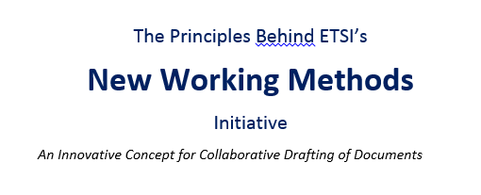

NWM – Concept Paper
Concept paper available at https://docbox.etsi.org/Board/2019_Board/BOARD(19)122_005_New_Working_Methods_Principles_and_concepts.docx

